Slide 1
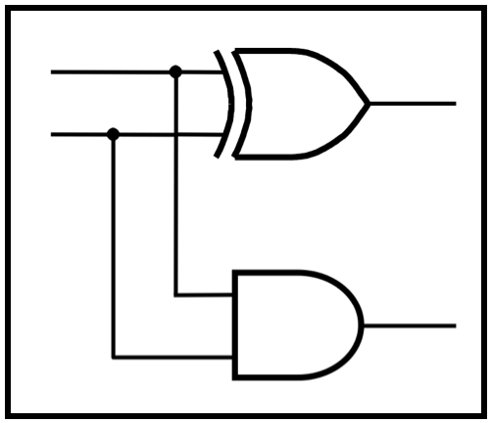
CprE 281:
Digital Logic
Instructor: Alexander Stoytchev
http://www.ece.iastate.edu/~alexs/classes/

Slide 2
Mealy State Model
CprE 281: Digital Logic
Iowa State University, Ames, IA
Copyright © Alexander Stoytchev

Slide 3
Administrative Stuff
Homework 10 is out
It is due on Monday Nov 14 @ 4pm

Slide 4
Administrative Stuff
Final Project

Slide 5
The general form of a synchronous sequential circuit
W
Combinational
Combinational
Flip-flops
circuit
Z
circuit
Q
Clock
[ Figure 6.1 from the textbook ]

Slide 6
Moore Type
W
Combinational
Combinational
Flip-flops
circuit
Z
circuit
Q
Clock

Slide 7
Mealy Type
W
Combinational
Combinational
Flip-flops
circuit
Z
circuit
Q
Clock

Slide 8
Sample Problem
Implement a 11 detector. In other words, the output should be equal to 1 if two consecutive 1’s have been detected on the input line. The output should become 1 as soon as the second 1 is detected in the input.

Slide 9
Sequences of input and output signals
Clock cycle:
t
0
t
1
t
2
t
3
t
4
t
5
t
6
t
7
t
8
t
9
t
10
w
:
0
1
0
1
1
0
1
1
1
0
1
z
:
0
0
0
0
1
0
0
1
1
0
0
[ Figure 6.22 from the textbook ]

Slide 10
Sequences of input and output signals
Clock cycle:
t
0
t
1
t
2
t
3
t
4
t
5
t
6
t
7
t
8
t
9
t
10
input
w
:
0
1
0
1
1
0
1
1
1
0
1
output
z
:
0
0
0
0
1
0
0
1
1
0
0
[ Figure 6.22 from the textbook ]

Slide 11
Sequences of input and output signals
Clock cycle:
t
0
t
1
t
2
t
3
t
4
t
5
t
6
t
7
t
8
t
9
t
10
input
w
:
0
1
0
1
1
0
1
1
1
0
1
output
z
:
0
0
0
0
1
0
0
1
1
0
0
[ Figure 6.22 from the textbook ]

Slide 12
Sequences of input and output signals
Clock cycle:
t
0
t
1
t
2
t
3
t
4
t
5
t
6
t
7
t
8
t
9
t
10
input
w
:
0
1
0
1
1
0
1
1
1
0
1
output
z
:
0
0
0
0
1
0
0
1
1
0
0
[ Figure 6.22 from the textbook ]

Slide 13
Sequences of input and output signals
Clock cycle:
t
0
t
1
t
2
t
3
t
4
t
5
t
6
t
7
t
8
t
9
t
10
input
w
:
0
1
0
1
1
0
1
1
1
0
1
output
z
:
0
0
0
0
1
0
0
1
1
0
0
[ Figure 6.22 from the textbook ]

Slide 14
Sequences of input and output signals
Clock cycle:
t
0
t
1
t
2
t
3
t
4
t
5
t
6
t
7
t
8
t
9
t
10
input
w
:
0
1
0
1
1
0
1
1
1
0
1
output
z
:
0
0
0
0
1
0
0
1
1
0
0
[ Figure 6.22 from the textbook ]

Slide 15
Sequences of input and output signals
Clock cycle:
t
0
t
1
t
2
t
3
t
4
t
5
t
6
t
7
t
8
t
9
t
10
input
w
:
0
1
0
1
1
0
1
1
1
0
1
output
z
:
0
0
0
0
1
0
0
1
1
0
0
[ Figure 6.22 from the textbook ]

Slide 16
Sequences of input and output signals
Clock cycle:
t
0
t
1
t
2
t
3
t
4
t
5
t
6
t
7
t
8
t
9
t
10
input
w
:
0
1
0
1
1
0
1
1
1
0
1
output
z
:
0
0
0
0
1
0
0
1
1
0
0
[ Figure 6.22 from the textbook ]

Slide 17
State diagram of an FSM that realizes the task
Reset
w = 1
z = 0
⁄
w = 0
z = 0
A
B
w = 1
z = 1
⁄
⁄
w = 0
z = 0
⁄
[ Figure 6.23 from the textbook ]

Slide 18
Let’s Do a Simulation
Clock cycle:
t
0
t
1
t
2
t
3
t
4
t
5
t
6
t
7
t
8
t
9
t
10
input
w
:
0
1
0
1
1
0
1
1
1
0
1
output
z
:
0
0
0
0
1
0
0
1
1
0
0
Reset
w = 1
z = 0
⁄
w = 0
z = 0
A
B
w = 1
z = 1
⁄
⁄
w = 0
z = 0
⁄

Slide 19
Let’s Do a Simulation
Clock cycle:
t
0
t
1
t
2
t
3
t
4
t
5
t
6
t
7
t
8
t
9
t
10
input
w
:
0
1
0
1
1
0
1
1
1
0
1
output
z
:
0
0
0
0
1
0
0
1
1
0
0
Reset
w = 1
z = 0
⁄
w = 0
z = 0
A
B
w = 1
z = 1
⁄
⁄
w = 0
z = 0
⁄

Slide 20
Let’s Do a Simulation
Clock cycle:
t
0
t
1
t
2
t
3
t
4
t
5
t
6
t
7
t
8
t
9
t
10
input
w
:
0
1
0
1
1
0
1
1
1
0
1
output
z
:
0
0
0
0
1
0
0
1
1
0
0
Reset
w = 1
z = 0
⁄
w = 0
z = 0
A
B
w = 1
z = 1
⁄
⁄
w = 0
z = 0
⁄

Slide 21
Let’s Do a Simulation
Clock cycle:
t
0
t
1
t
2
t
3
t
4
t
5
t
6
t
7
t
8
t
9
t
10
input
w
:
0
1
0
1
1
0
1
1
1
0
1
output
z
:
0
0
0
0
1
0
0
1
1
0
0
Reset
w = 1
z = 0
⁄
w = 0
z = 0
A
B
w = 1
z = 1
⁄
⁄
w = 0
z = 0
⁄

Slide 22
Let’s Do a Simulation
Clock cycle:
t
0
t
1
t
2
t
3
t
4
t
5
t
6
t
7
t
8
t
9
t
10
input
w
:
0
1
0
1
1
0
1
1
1
0
1
output
z
:
0
0
0
0
1
0
0
1
1
0
0
Reset
w = 1
z = 0
⁄
w = 0
z = 0
A
B
w = 1
z = 1
⁄
⁄
w = 0
z = 0
⁄

Slide 23
Let’s Do a Simulation
Clock cycle:
t
0
t
1
t
2
t
3
t
4
t
5
t
6
t
7
t
8
t
9
t
10
input
w
:
0
1
0
1
1
0
1
1
1
0
1
output
z
:
0
0
0
0
1
0
0
1
1
0
0
Reset
w = 1
z = 0
⁄
w = 0
z = 0
A
B
w = 1
z = 1
⁄
⁄
w = 0
z = 0
⁄

Slide 24
Let’s Do a Simulation
Clock cycle:
t
0
t
1
t
2
t
3
t
4
t
5
t
6
t
7
t
8
t
9
t
10
input
w
:
0
1
0
1
1
0
1
1
1
0
1
output
z
:
0
0
0
0
1
0
0
1
1
0
0
Reset
w = 1
z = 0
⁄
w = 0
z = 0
A
B
w = 1
z = 1
⁄
⁄
w = 0
z = 0
⁄

Slide 25
Let’s Do a Simulation
Clock cycle:
t
0
t
1
t
2
t
3
t
4
t
5
t
6
t
7
t
8
t
9
t
10
input
w
:
0
1
0
1
1
0
1
1
1
0
1
output
z
:
0
0
0
0
1
0
0
1
1
0
0
Reset
w = 1
z = 0
⁄
w = 0
z = 0
A
B
w = 1
z = 1
⁄
⁄
w = 0
z = 0
⁄

Slide 26
Let’s Do a Simulation
Clock cycle:
t
0
t
1
t
2
t
3
t
4
t
5
t
6
t
7
t
8
t
9
t
10
input
w
:
0
1
0
1
1
0
1
1
1
0
1
output
z
:
0
0
0
0
1
0
0
1
1
0
0
Reset
w = 1
z = 0
⁄
w = 0
z = 0
A
B
w = 1
z = 1
⁄
⁄
w = 0
z = 0
⁄

Slide 27
Let’s Do a Simulation
Clock cycle:
t
0
t
1
t
2
t
3
t
4
t
5
t
6
t
7
t
8
t
9
t
10
input
w
:
0
1
0
1
1
0
1
1
1
0
1
output
z
:
0
0
0
0
1
0
0
1
1
0
0
Reset
w = 1
z = 0
⁄
w = 0
z = 0
A
B
w = 1
z = 1
⁄
⁄
w = 0
z = 0
⁄

Slide 28
Let’s Do a Simulation
Clock cycle:
t
0
t
1
t
2
t
3
t
4
t
5
t
6
t
7
t
8
t
9
t
10
input
w
:
0
1
0
1
1
0
1
1
1
0
1
output
z
:
0
0
0
0
1
0
0
1
1
0
0
Reset
w = 1
z = 0
⁄
w = 0
z = 0
A
B
w = 1
z = 1
⁄
⁄
w = 0
z = 0
⁄

Slide 29
Let’s Do a Simulation
Clock cycle:
t
0
t
1
t
2
t
3
t
4
t
5
t
6
t
7
t
8
t
9
t
10
input
w
:
0
1
0
1
1
0
1
1
1
0
1
output
z
:
0
0
0
0
1
0
0
1
1
0
0
Reset
w = 1
z = 0
⁄
w = 0
z = 0
A
B
w = 1
z = 1
⁄
⁄
w = 0
z = 0
⁄

Slide 30
Let’s Do a Simulation
Clock cycle:
t
0
t
1
t
2
t
3
t
4
t
5
t
6
t
7
t
8
t
9
t
10
input
w
:
0
1
0
1
1
0
1
1
1
0
1
output
z
:
0
0
0
0
1
0
0
1
1
0
0
Reset
w = 1
z = 0
⁄
w = 0
z = 0
A
B
w = 1
z = 1
⁄
⁄
w = 0
z = 0
⁄

Slide 31
Let’s Do a Simulation
Clock cycle:
t
0
t
1
t
2
t
3
t
4
t
5
t
6
t
7
t
8
t
9
t
10
input
w
:
0
1
0
1
1
0
1
1
1
0
1
output
z
:
0
0
0
0
1
0
0
1
1
0
0
Reset
w = 1
z = 0
⁄
w = 0
z = 0
A
B
w = 1
z = 1
⁄
⁄
w = 0
z = 0
⁄

Slide 32
Let’s Do a Simulation
Clock cycle:
t
0
t
1
t
2
t
3
t
4
t
5
t
6
t
7
t
8
t
9
t
10
input
w
:
0
1
0
1
1
0
1
1
1
0
1
output
z
:
0
0
0
0
1
0
0
1
1
0
0
Reset
w = 1
z = 0
⁄
w = 0
z = 0
A
B
w = 1
z = 1
⁄
⁄
w = 0
z = 0
⁄

Slide 33
Let’s Do a Simulation
Clock cycle:
t
0
t
1
t
2
t
3
t
4
t
5
t
6
t
7
t
8
t
9
t
10
input
w
:
0
1
0
1
1
0
1
1
1
0
1
output
z
:
0
0
0
0
1
0
0
1
1
0
0
Reset
w = 1
z = 0
⁄
w = 0
z = 0
A
B
w = 1
z = 1
⁄
⁄
w = 0
z = 0
⁄

Slide 34
Let’s Do a Simulation
Clock cycle:
t
0
t
1
t
2
t
3
t
4
t
5
t
6
t
7
t
8
t
9
t
10
input
w
:
0
1
0
1
1
0
1
1
1
0
1
output
z
:
0
0
0
0
1
0
0
1
1
0
0
Reset
w = 1
z = 0
⁄
w = 0
z = 0
A
B
w = 1
z = 1
⁄
⁄
w = 0
z = 0
⁄

Slide 35
Let’s Do a Simulation
Clock cycle:
t
0
t
1
t
2
t
3
t
4
t
5
t
6
t
7
t
8
t
9
t
10
input
w
:
0
1
0
1
1
0
1
1
1
0
1
output
z
:
0
0
0
0
1
0
0
1
1
0
0
Reset
w = 1
z = 0
⁄
w = 0
z = 0
A
B
w = 1
z = 1
⁄
⁄
w = 0
z = 0
⁄

Slide 36
Let’s Do a Simulation
Clock cycle:
t
0
t
1
t
2
t
3
t
4
t
5
t
6
t
7
t
8
t
9
t
10
input
w
:
0
1
0
1
1
0
1
1
1
0
1
output
z
:
0
0
0
0
1
0
0
1
1
0
0
Reset
w = 1
z = 0
⁄
w = 0
z = 0
A
B
w = 1
z = 1
⁄
⁄
w = 0
z = 0
⁄

Slide 37
Now Let’s Do the State Table for this FSM
Reset
w
=
1
⁄
z
=
0
w
=
0
⁄
z
=
0
A
B
w
=
1
⁄
z
=
1
w
=
0
⁄
z
=
0
Present
Next state
Output
z
state
w
=
0
w
=
1
w
=
0
w
=
1
A
B

Slide 38
Now Let’s Do the State Table for this FSM
Reset
w
=
1
⁄
z
=
0
w
=
0
⁄
z
=
0
A
B
w
=
1
⁄
z
=
1
w
=
0
⁄
z
=
0
Present
Next state
Output
z
state
w
=
0
w
=
1
w
=
0
w
=
1
A
A
B
0
0
B
A
B
0
1

Slide 39
The State Table for this FSM
Present
Next state
Output
z
state
w
=
0
w
=
1
w
=
0
w
=
1
A
A
B
0
0
B
A
B
0
1
[ Figure 6.24 from the textbook ]

Slide 40
Let’s Do the State-assigned Table
Present
Next state
Output
z
state
w
=
0
w
=
1
w
=
0
w
=
1
A
A
B
0
0
B
A
B
0
1
Present
Next state
Output
state
w
=
0
w
=
1
w
=
0
w
=
1
y
Y
Y
z
z
A
0
B
1

Slide 41
Let’s Do the State-assigned Table
Present
Next state
Output
z
state
w
=
0
w
=
1
w
=
0
w
=
1
A
A
B
0
0
B
A
B
0
1
Present
Next state
Output
state
w
=
0
w
=
1
w
=
0
w
=
1
y
Y
Y
z
z
A
0
0
1
0
0
B
1
0
1
0
1

Slide 42
The State-assigned Table
Present
Next state
Output
state
w
=
0
w
=
1
w
=
0
w
=
1
y
Y
Y
z
z
A
0
0
1
0
0
B
1
0
1
0
1
[ Figure 6.25 from the textbook ]

Slide 43
The State-assigned Table
Present
Next state
Output
state
w
=
0
w
=
1
w
=
0
w
=
1
y
Y
Y
z
z
A
0
0
1
0
0
B
1
0
1
0
1
Y = D = w
z = wy
[ Figure 6.25 from the textbook ]

Slide 44
The State-assigned Table
Present
Next state
Output
state
w
=
0
w
=
1
w
=
0
w
=
1
y
Y
Y
z
z
A
0
0
1
0
0
B
1
0
1
0
1
Y = D = w
z = wy
This assumes D flip-flop
[ Figure 6.25 from the textbook ]

Slide 45
Circuit Implementation of the FSM
z
w
D
Q
y
Clock
Q
Resetn
Y = D = w
z = wy
[ Figure 6.26 from the textbook ]

Slide 46
Circuit & Timing Diagram
z
w
D
Q
y
Clock
Q
Resetn
(a) Circuit
t
t
t
t
t
t
t
t
t
t
t
0
1
2
3
4
5
6
7
8
9
10
Clock
1
0
w
1
0
y
1
0
z
1
0
(b) Timing diagram
[ Figure 6.26 from the textbook ]

Slide 47
What if we wanted the output signal to be delayed by 1 clock cycle?

Slide 48
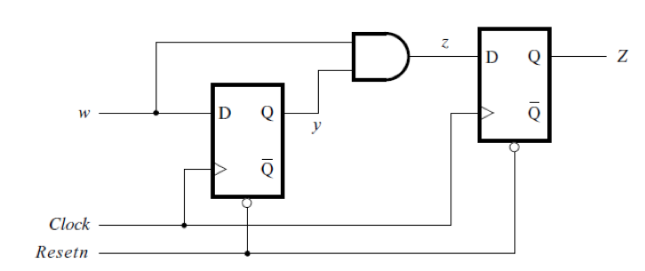
Circuit Implementation of the Modified FSM
[ Figure 6.27a from the textbook ]

Slide 49
Circuit Implementation of the Modified FSM
This flip-flop delays the
output signal by one clock cycle
[ Figure 6.27a from the textbook ]

Slide 50
We Have Seen This Diagram Before
Y
y
Y₁(w, y₂, y₁) = w
2
2
z
D
Q
Y₂(w, y₂, y₁) = wy₁
Q
z(y₂, y₁) = y₂
Y
y
w
1
1
D
Q
Clock
Q
Resetn
[ Figure 6.17 from the textbook ]

Slide 51
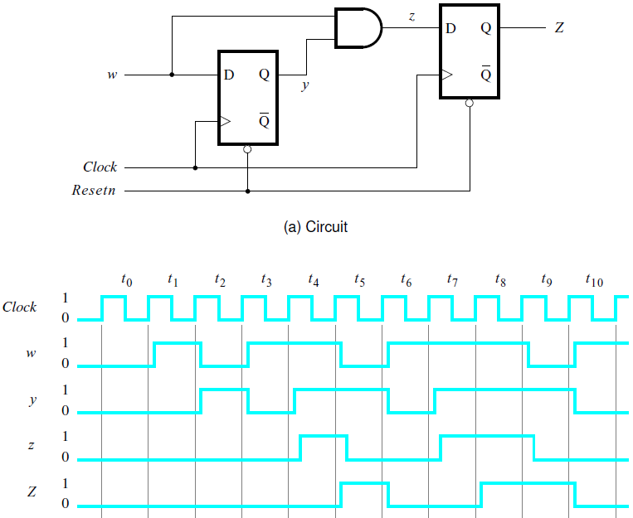
Circuit & Timing Diagram
[ Figure 6.27 from the textbook ]

Slide 52
The general form of a synchronous sequential circuit
W
Combinational
Combinational
Flip-flops
circuit
Z
circuit
Q
Clock
[ Figure 6.1 from the textbook ]

Slide 53
Moore Type
W
Combinational
Combinational
Flip-flops
circuit
Z
circuit
Q
Clock

Slide 54
Mealy Type
W
Combinational
Combinational
Flip-flops
circuit
Z
circuit
Q
Clock

Slide 55
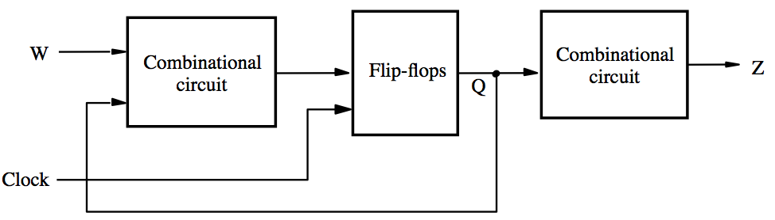
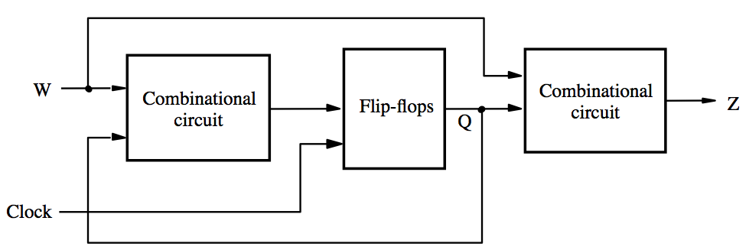
Moore Mealy

Slide 56
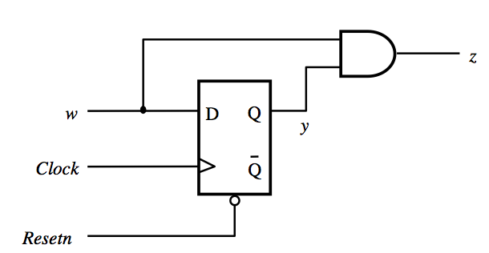
Moore Mealy

Slide 57
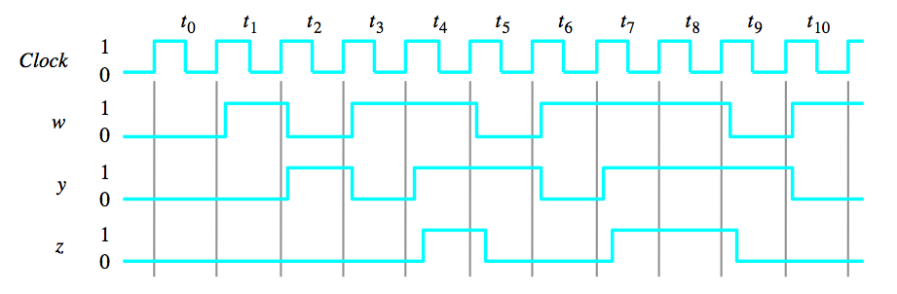
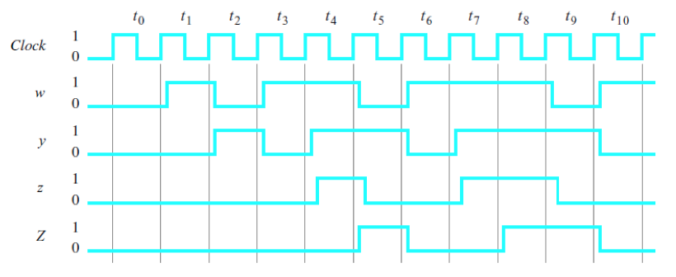
Mealy
Moore

Slide 58
Notice that the output of the Moore machine is delayed by one clock cycle
Mealy
Moore

Slide 59
Questions?

Slide 60
THE END

